Slide 1

How to get a Data science JOb?
By Amy Guan, Kanjicai (Brock) Dong, John Boer

Slide 2


Background
What insights can we gain based on the historical job openings in data science from major job search websites (including indeed, careerbuilder, glassdoor, etc)?
How can we translate those insights into competitive advantage in our job seeking?

Slide 3
QUESTIONS TO ADDRESS
What:
Job title, job type (full time vs. contractor), job level (entry vs. experienced), industry breakdown, and salary expectation of job openings
Where:
Geographical distribution & evolution
How:
Technical / hard skills in general
Soft skills in general
Industry breakdown of desired technical tools

Slide 4
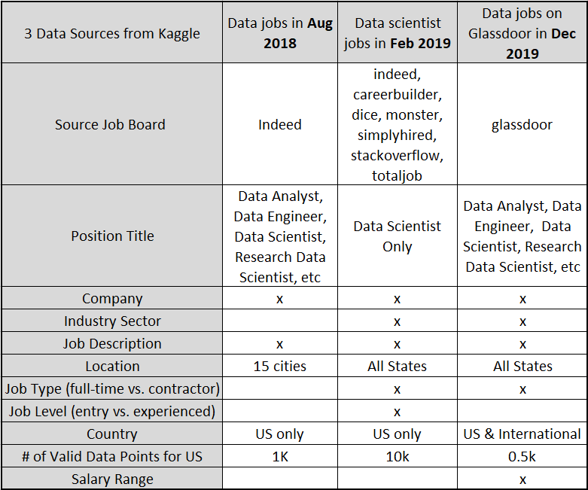
Data

Slide 5
Data Cleanup, Exploration & Analysis
String-Intensive Project:
Long paragraphs in job description column;
Great varieties in job title, level, industry sector etc.; Free-style in job description
Three data sets are 10 months apart;
Significantly different dataset size; Merging 3 will overweight one dataset while diluting the other
Note each data set has its own limitations on the info provided;
Data cleanup and analysis goals:
Define new inferred tags based on raw data
Extract all valid data and make the 3 data sets to be consistent
Present data in comparable data frame format to shed light on the questions.

Slide 6
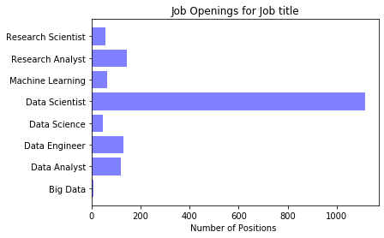
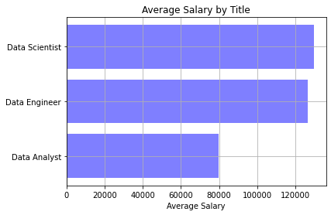
Overview of Job openings – Title/Salary
AUG2018 DEC2019

Slide 7
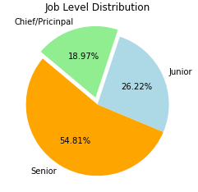
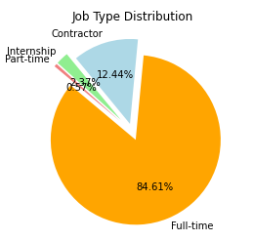
Overview of Job openings – Level & Type

Slide 8
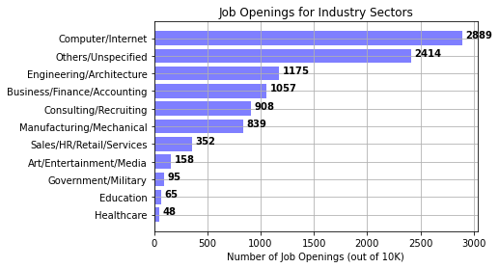
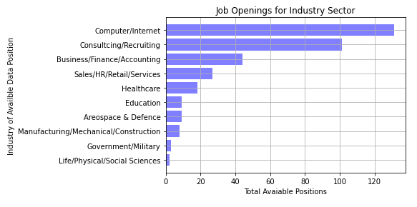
Industry breakdown of Job Openings
Top 3 Technical Skills:
Computer/Internet; Business/Finance/Accounting; Consulting/Recruiting
FEB2019 DEC2019

Slide 9
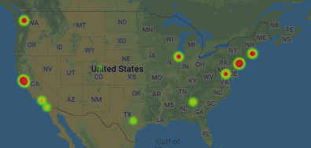
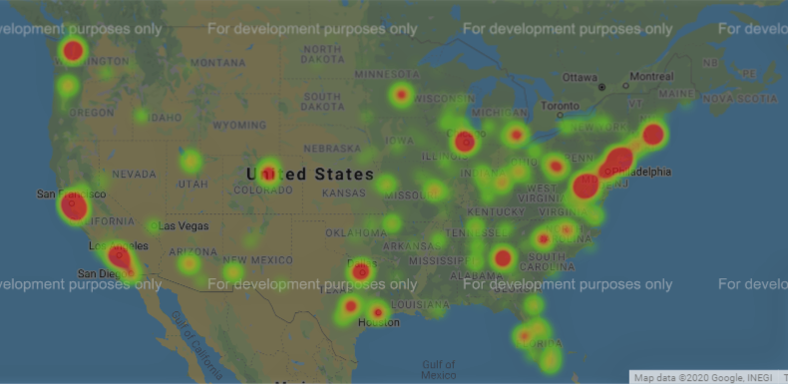
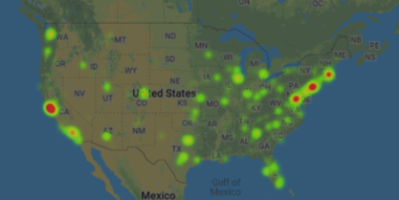
Maps for Job Locations in the US
(AUG)2018 (FEB)2019 (DEC)2019

Slide 10
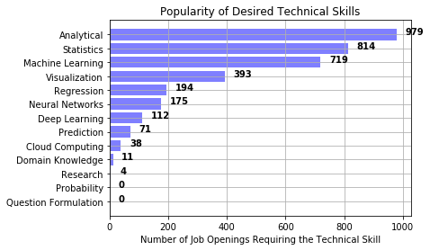
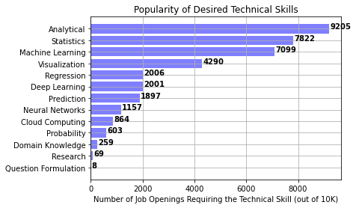
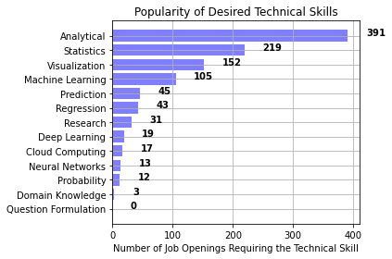
Desired Technical Skills
Top 4 Technical Skills:
Analytical, Statistics, Machine Learning and Visualization
AUG2018 FEB2019 DEC2019

Slide 11
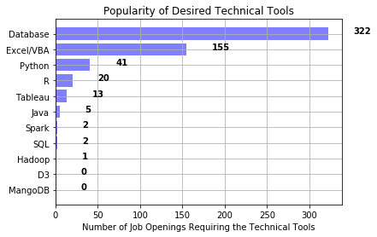
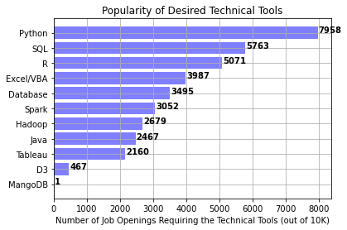
Desired Technical TOOLs
Top 5 Technical Tools:
Python, R, Database, Excel/VBA, SQL
AUG2018 FEB2019

Slide 12
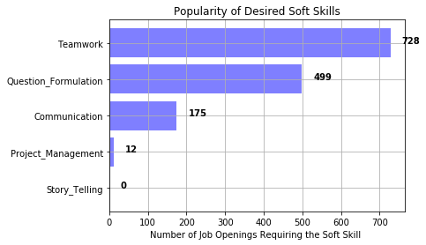
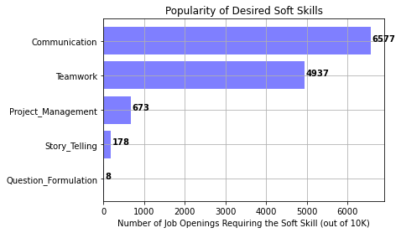
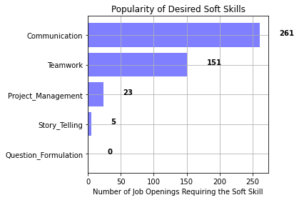
Desired SOft Skills
AUG2018 FEB2019 DEC2019

Slide 13
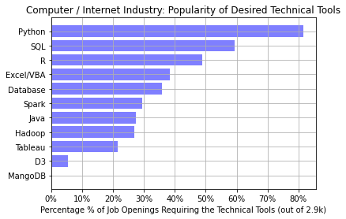
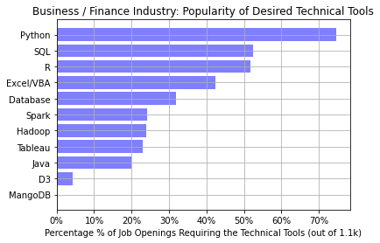
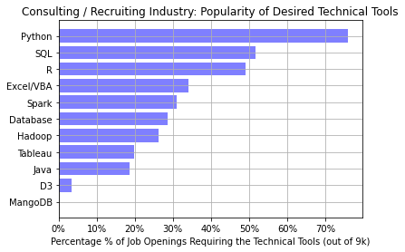
Industry breakdown of Technical skills
Feb 2019

Slide 14
Discussion & Conclusion
High compensation: for data scientist roles, EXPECT AVERAGE ANNUAL SALARY of $130K !
Most employers are looking for experienced candidates; >25% openings are for entry-level candidates.
West and east coasts stand out in the DS job market as expected; Chicago, Denver, Atlanta and Dallas are a few hot spots.
Within Texas, Dallas > Austin > Houston
Compared to the GDP % breakdown by industries, the data scientist job openings in Healthcare is much lower than expected; one possibility is the healthcare companies tend to resort to consulting/recruiting agents to search for candidates – still needs to be further confirmed from the data;
Make sure you include hottest keywords in technical skills, technical tools and soft skills!
Analytical, Statistics, Machine Learning and Visualization
Python, R, Database, SQL & Excel/VBA
Teamwork, Communication & Project Management

Slide 15
Post Mortem
Challenges:
Keywords search issues: free-style texts
Identify the common grounds for 3 significantly different data sources
Lesson Learned:
Pull a larger dataset pool to choose from; select the datasets with more consistency and similar size from the larger pool
With comparable datasets, more quantitative analyses are possible, including hypothesis testing for different datasets

Slide 16

Questions

